Slide 1
Workshop
Overview
Module 1: Overview of the Microsoft Azure Platform
Module 2: Building Application Infrastructure in Azure
Module 3: Hosting Web Applications on the Azure Platform
Module 4: Storing SQL Data in Azure
Module 5: Designing a Communication Strategy by Using Queues and Service Bus

Slide 2
Module 3:
Hosting Web Applications on the Azure Platform

Slide 3
Module 3 Overview
This module provides an overview of the Azure Web Apps service.
Lesson 1, “Azure Web Apps”, describes the Web Apps service in Azure.
Lesson 2, “Hosting Web Applications in Azure“, describes the behavior and lifecycle of an Azure Web App.
Lesson 3, “Configuring an Azure Web App”, discusses the various configuration options available to change the behavior of your Web App.
Lesson 4, “Publishing an Azure Web App”, describes the process for publishing a web application using WebDeploy to Azure Web Apps.
Objectives
After completing this module, you will be able to:
Create a Web App instance.
Publish a simple ASP.NET web application to Web Apps.
Monitor a Web App instance.

Slide 4
Module 3 Continued. . .
Azure Web Apps > Overview
Overview
In many scenarios, it is preferable to use a quick and easy way to deploy web applications to the cloud rather than to reengineer the web applications as cloud projects. Web Apps allow you to quickly create a new Web App and iterate changes to the Web App in an agile manner.
This module describes the Web Apps service.
Objectives
After completing this module, you will be able to:
Describe the Web Apps service.
List the different tiers for a Web App.

Slide 5
Module 3 Continued. . .
Azure Web Apps > What is Azure App Service?
VIDEO

Slide 6
Module 3 Continued. . .
Azure Web Apps > Azure Web Apps Overview
Azure Web Apps Overview
Web Apps is a low friction Platform-as-a-Service (PaaS) offering to host your web applications in the Azure platform. The service is fully managed and you can easily configure advanced features such as AlwaysOn, custom domains, and autoscale by using either portal.

Slide 7
Module 3 Continued. . .
Azure Web Apps > Azure Web Apps Overview
Flexibility
You can use a variety of integrated development environments (IDEs) and frameworks, such as .NET, Java, PHP, Node.js, or Python, to develop your web applications that are eventually deployed to Azure Web Apps. You can use Git and Kudu to deploy Node.js or PHP web applications. You also can deploy web applications that are developed in Microsoft Visual Studio to Web Apps by using the File Transfer Protocol (FTP) or the Web Deploy protocol.

Slide 8
Module 3 Continued. . .
Azure Web Apps > Azure Web Apps Overview
Scalability
Because Web Apps is a fully managed service implementation, you can focus on developing your application and solving business problems instead of the hosting implementation and hardware scaling or specifics. You can easily scale up a stateless web application by configuring autoscale in the portal. Autoscale creates multiple instances of your Web App that are automatically load balanced so that your application can meet potential spikes in demand.

Slide 9
Module 3 Continued. . .
Azure Web Apps > How is App Service Different than Infrastructure?
VIDEO

Slide 10
Module 3 Continued. . .
Azure Web Apps > Web App Tiers
Web App Tiers
The Web Apps service is available in four tiers: Free, Shared, Basic, and Standard. You can use App Service Plans to assign a tier to a group of Web App instances. At any time, you can switch the tier for a App Service Plan. In the Free and Shared tiers, you are billed per hour for each instance of the Web App. In the Basic and Standard tiers, you are billed per hour for your dedicated virtual machine (compute instance) and not per Web App.

Slide 11
Module 3 Continued. . .
Azure Web Apps > Web App Tiers
. . . The Free tier offers 10 free Web App instances. All the instances share pool of 60 minutes of CPU time per day. The free tier also enforces an outbound data limit of 165 megabytes (MB) per day. These instances are hosted on shared compute instances or virtual machines where they share resources with many other Web App tenants.

Slide 12
Module 3 Continued. . .
Azure Web Apps > Web App Tiers
. . . The Shared tier has a lot in common with the Free tier, but many restrictions are relaxed. For example, the Outbound Data limit is removed and each instance is allowed 240 minutes of CPU time per day that is not pooled. You can also have up to 100 Web App instances in this tier. In this tier, you also can use a custom domain with your Web App. You also can manually scale out to six different instances of your Web App. These Web App instances are hosted in different shared compute instances and are load balanced automatically.

Slide 13
Module 3 Continued. . .
Azure Web Apps > Web App Tiers
. . . In the Basic tier, your Web App instances are not in a shared environment. Instead, you have a dedicated compute instance where you can host as many Web App instances as you want. In addition to the features offered by the Free and Shared tiers, this tier also supports AlwaysOn, Secure Socket Layer (SSL) for custom domains, and a limited quantity of WebSocket connections (350 per Web App). You can manually scale out this tier to a maximum of three dedicated compute instances.

Slide 14
Module 3 Continued. . .
Azure Web Apps > Web App Tiers
. . . The Standard tier offers the same functionality as the Basic, Free and Shared tiers, but includes additional features such as Publishing Slots and Backups. With the autoscale functionality, you can automatically scale your Web App based on a metric or a schedule.

Slide 15
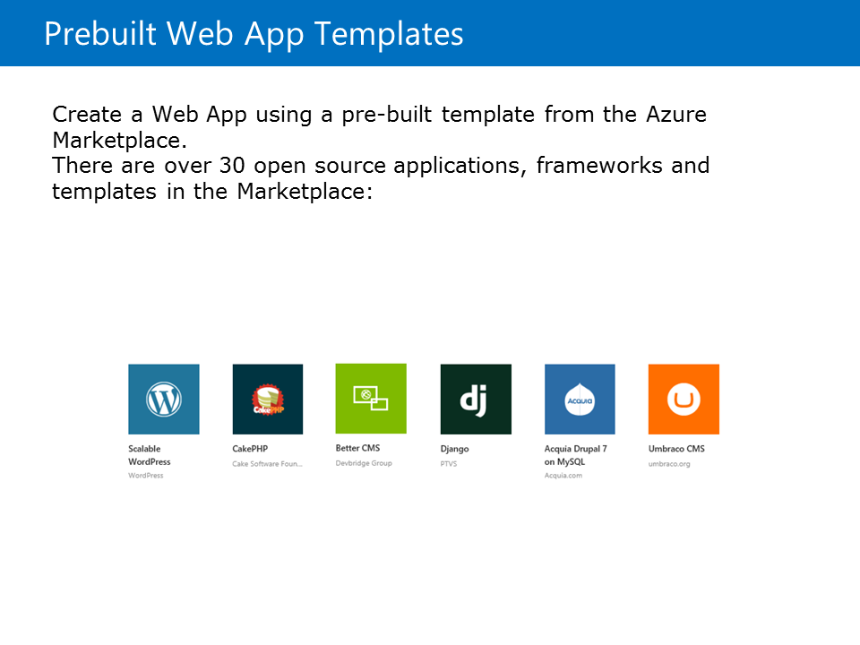
Module 3 Continued. . .
Azure Web Apps > Web App Tiers
Prebuilt Web App Templates
Most of the applications that are available in the Windows Web App Gallery () are also available in Microsoft Azure Marketplace.

Slide 16
Module 3 Continued. . .
Azure Web Apps > Using App Service Web Apps
VIDEO

Slide 17
Module 3 Continued. . .
Hosting Web Applications in Azure > Overview
One of the advantages of deploying a web application in Web Apps is that it has a familiar hosting model. You can host applications in Web Apps by using Internet Information Server (IIS) and Web Deploy packages in the same way that you host them in an on-premises environment. You can host applications in Web Apps by using Internet Information Server (IIS) and Web Deploy packages in the same way that you host them in an on-premises environment. This module describes the lifecycle of Web App instances and how they are hosted.

Slide 18
Module 3 Continued. . .
Hosting Web Applications in Azure > Web App Configuration GitHub Project Kudu
Kudu is the engine behind most of the enhanced features that are offered by Web Apps. Kudu can also be used with your local web application projects. The Kudu project is an open-source project that is available on GitHub, and it supports many features such as:
Web application publishing from a source control system
Deployment hooks
Web hooks
Web Jobs

Slide 19
Module 3 Continued. . .
Hosting Web Applications in Azure > Web App ConfigurationGitHub Project Kudu
You can access the Kudu console for your Web App by using the following URL format: https://[Web App Name].scm.azureWeb Apps.net
Kudu also provides an endpoint that the IIS Manager can use to remotely configure the web application. This provides a safer way to modify the application’s Web.config file. Managing your web application using KUDU or the IIS Manager endpoint is not prone to errors unlike the traditional method of accessing the web application’s file system and editing the configuration files.

Slide 20
Module 3 Continued. . .
Hosting Web Applications in Azure > App Service Plans
App Service Plans
You can group your Web App instances so that the capacity can be shared among them. At any given time, a Web App instance can only be associated with a single App Service Plan. A single Resource Group can contain multiple App Service Plans.
A App Service Plan is associated with a pricing tier.

Slide 21
Module 3 Continued. . .
Hosting Web Applications in Azure > App Service Plans
. . . When you create a new Web App instance, you can either specify a App Service Plan or have a App Service Plan selected for you. By default, if your subscription does not have any App Service Plan, a new Standard tier App Service Plan is created automatically. If your subscription has an existing App Service Plan, then that plan is selected, by default, when you create a new Web App instance. You can also create a new App Service Plan when you create a new Web App instance.

Slide 22
Module 3 Continued. . .
Hosting Web Applications in Azure > App Service Plans
. . . All Web Apps within a App Service Plan are scaled together. Manual scale settings or autoscale settings are configured on the entire App Service Plan. For example, you can configure a Standard App Service Plan to have a minimum of three instances and a maximum of five instances and autoscale by monitoring the disk queue depth metric. Under an average load, you can expect to have four instances. This means that there are four dedicated compute instances and all your Web App instances have a copy on each dedicated instance that are load balanced by using the internal load balancer of Web Apps.

Slide 23
Module 3 Continued. . .
Hosting Web Applications in Azure > How are Mobile and API Apps related to Web Apps & What are Logic Apps?
VIDEO & VIDEO

Slide 24
Module 3 Continued. . .
Configuring an Azure Web App > Overview
Overview
Web Apps provides many features that you can use to expand your web application’s capabilities. By using the Management Portal, you can enable different features of a Web App and modify the custom settings for the Web App without redeploying the web application.
This module lists the different configuration options that are available for a Web App.

Slide 25
Module 3 Continued. . .
Configuring an Azure Web App > AlwaysOn
AlwaysOn
When you host your ASP.NET applications on IIS, you can isolate them into application pools. IIS improves the performance of your web server by automatically recycling application pools on a scheduled basis and by running the initial ASP.NET startup tasks for your web application only when the first request is processed. This prevents your application from using unnecessary resources when it is not requested by clients.

Slide 26
Module 3 Continued. . .
Configuring an Azure Web App > AlwaysOn
. . . If your ASP.NET application is not precompiled, the application is compiled just-in-time (JIT) at startup and then the ASP.NET startup tasks will run. You can inject your own logic into ASP.NET’s startup by implementing a Global.asax file with the HttpApplication class. If your ASP.NET application is precompiled, the startup tasks run immediately. Regardless of your choice, these startup tasks can be long and resource intensive. This will cause the first request or any request that is issued immediately after an application pool recycle to take a lot longer than normal to process.

Slide 27
Module 3 Continued. . .
Configuring an Azure Web App > AlwaysOn
. . . In IIS, this can be resolved by setting your application pool’s application start mode to Always Running. In Web Apps, you can accomplish this by using the AlwaysOn feature. AlwaysOn prevents your application from recycling due to going idle. AlwaysOn also improves your application startup time for early clients.

Slide 28
Module 3 Continued. . .
Configuring an Azure Web App > AlwaysOn
. . . This is accomplished by the Azure platform that regularly pings your Web App so that it is always active and is in a running state. This ensures that your application is already running before your first client requests are issued. It also ensures that your application remains in the running state and starts up in case of a recycle.
AlwaysOn is available only for the Basic and Standard tier Web Apps.

Slide 29
Module 3 Continued. . .
Configuring an Azure Web App > Domain Names
Domain Names
When you create a new Web App, a subdomain of the azureWeb Apps.net domain is assigned by using the following format:
[http|https]://<sitename>.azureWeb Apps.net
Azure also assigns a virtual Internet Protocol (IP) address for the same Web App instance. You can choose to use a custom domain name for your Web App and configure the custom domain name in the portal.

Slide 30
Module 3 Continued. . .
Configuring an Azure Web App > Domain Names
. . . Custom domain names are not supported for Free tier Web App instances.
To view the Manage Custom Domains dialog box for a Web App instance, you can either use the Configure tab or the Manage Domains button in the portal.
The Manage custom domains configuration dialog box allows you to associate an external domain with your Web App instance.

Slide 31
Module 3 Continued. . .
Configuring an Azure Web App > Domain Names
. . . To view the Manage Custom Domains dialog box for a Web App instance, you can either use the Configure tab or the Manage Domains button in the portal. The Manage custom domains configuration dialog box allows you to associate an external domain with your Web App instance. This dialog box includes instructions on how to use a custom domain along with the virtual IP address for your Web App. If you are using multiple instances within a single Web App, the virtual IP address will be load-balanced across those instances.

Slide 32
Module 3 Continued. . .
Configuring an Azure Web App > Domain Names
. . . At this point, you can use your domain registrar’s Web App to configure a canonical name (CNAME) record and an address (A) records by using the following information:
HOST RECORD TYPE IP ADDRESS/URL
@ A 0.0.0.0 (IP address specified in portal)
www CNAME [Web App name].azureWeb Apps.net
After you complete this, you can use the same dialog box in the Azure Management portal to enable the custom domain on your Web App.

Slide 33
Module 3 Continued. . .
Configuring an Azure Web App > Autoscaling Web Apps
Autoscaling Web Apps
In many distributed application scenarios, you might want to scale out (horizontally) your application by increasing the number of instances of the application. Using the built-in load balancer, you can spread the load for your web application across multiple instances. This minimizes the per instance cost and ensures that your application meets the increasing demand from client devices or browsers.

Slide 34
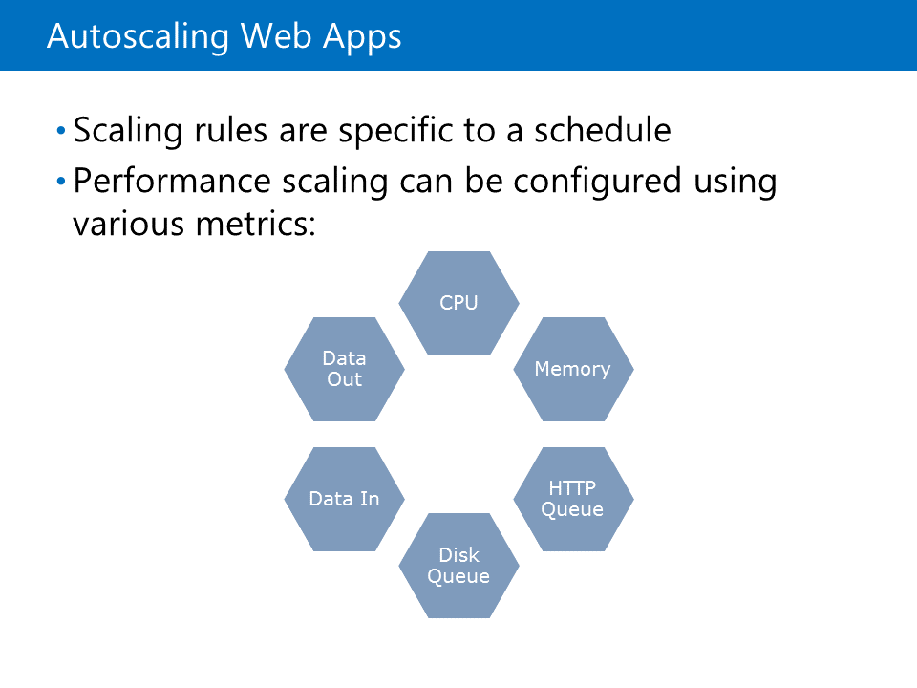
Module 3 Continued. . .
Configuring an Azure Web App > Autoscaling Web Apps
With unpredictable application workloads, you can sometimes end up overestimating or underestimating the number of Web Apps that are needed to provide the best user experience.

Slide 35
Module 3 Continued. . .
Configuring an Azure Web App > Autoscaling Web Apps
. . . Traditionally, overestimation is used to ensure that each user has a satisfactory experience with your web application. Ideally, you want your web platform to use the extra instances only when it is necessary and to shut down the same instances when they are no longer needed.
You can use autoscale to control horizontal scaling by using metrics and schedules. This gives you the flexibility to have your application’s resource allocation closely aligned with the actual utilization.

Slide 36
Module 3 Continued. . .
Configuring an Azure Web App > Autoscaling Web Apps
By using autoscale, you can:
Minimize unnecessary resource cost by removing Web App instances when they are no longer needed.
Maximize performance and client response by creating Web App instances when a measured threshold is met.

Slide 37
Module 3 Continued. . .
Configuring an Azure Web App > Autoscaling Web Apps
When you define the autoscale configuration, you must specify the schedules. You can use schedules to specify different autoscale rules for different date and time periods. By default, a schedule is created for all time. After you create or select a schedule, you can define a metric to measure configuration values such as:
CPU Utilization Percentage (range)
Storage Queue Length (threshold)

Slide 38
Module 3 Continued. . .
Configuring an Azure Web App > Autoscaling Web Apps
After you save this configuration, you can monitor your autoscale history for your Web App by using the same configuration dialogs. In the Preview Portal, an enhanced list of autoscale metrics are available that you can use to scale your Web App such as:
Average Memory
HTTP Queue Depth
Disk Queue Depth

Slide 39
Module 3 Continued. . .
Configuring an Azure Web App > Differences between App Service and App Service Environments
VIDEO

Slide 40
Module 3 Continued. . .
Publishing an Azure Web App > Overview
After developing a web application, you can use Web Deploy to publish the web application to Azure. By using the publish wizard in Visual Studio, you can customize the configuration settings and connection strings before you publish the web application.

Slide 41
Module 3 Continued. . .
Publishing an Azure Web App > The Web Deploy Protocol
Web Deploy (msdeploy) is a combination of a package format and an IIS add-in that gives administrators and developers incredible flexibility to manage and deploy container applications. A Web Deploy package is a simple representation of an IIS Web App. The package can contain the following data about your Web application:
Binaries | Content | XML configuration | Databases
Registry modifications | Assemblies and Globally Assembly Cache (GAC) references

Slide 42
Module 3 Continued. . .
Publishing an Azure Web App > The Web Deploy Protocol
You can create Web Deploy packages manually or by using an IDE such as Visual Studio or WebMatrix. You can hand off the package to an administrator asynchronously so that he or she can install the package in any IIS install with the Web Deploy add-in. At installation, the administrator provides configuration values for items such as SQL database connection strings. You also can use Web Deploy can to synchronize changes to an application among a server farm.

Slide 43
Module 3 Continued. . .
Publishing an Azure Web App > The Web Deploy Protocol
. . . You can extract a Web Deploy package from an existing IIS Web App and import it into IIS Web Apps that are on other machines within the same farm. Web Deploy can also expose an endpoint that allows developers to remotely deploy applications to a web server without having direct access to the actual web server.
You can use Web Deploy packages to synchronize development, test, staging, and production environments regardless of where they are hosted.

Slide 44
Module 3 Continued. . .
Publishing an Azure Web App > The Web Deploy Protocol
. . . Azure Web Apps allows developers to publish a Web Deploy package to a Web App instance by using the remote deploy service. Connection strings and databases are already managed for you to provide a seamless publish experience.

Slide 45
Module 3 Continued. . .
Publishing an Azure Web App > Continuous Deployment using Web Apps
VIDEO

Slide 46
Module 3 Continued. . .
Publishing an Azure Web App > Continuous Deployment using Web Apps
Lab: Creating an ASP.NET Web App Using an Azure Web App

